Slide 1

Capstone Project – University Success Analysis
NITHYA K

Slide 2
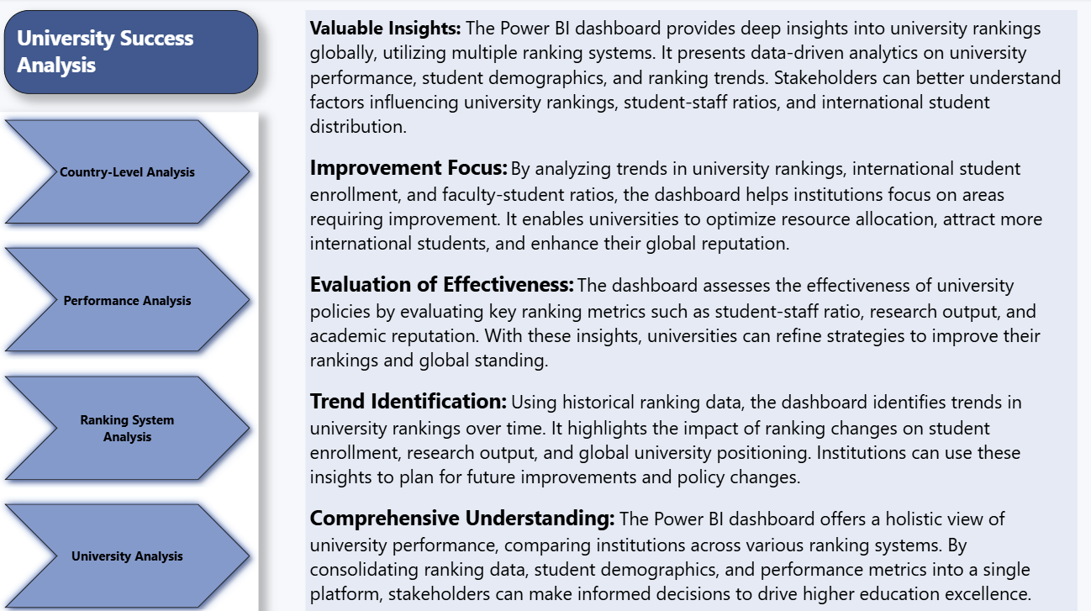

Slide 3
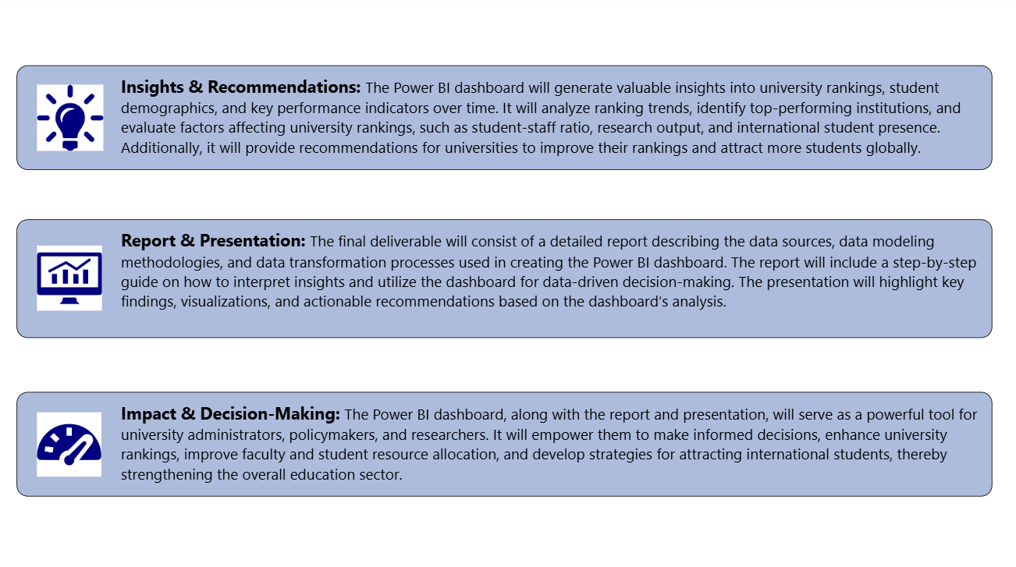

Slide 4
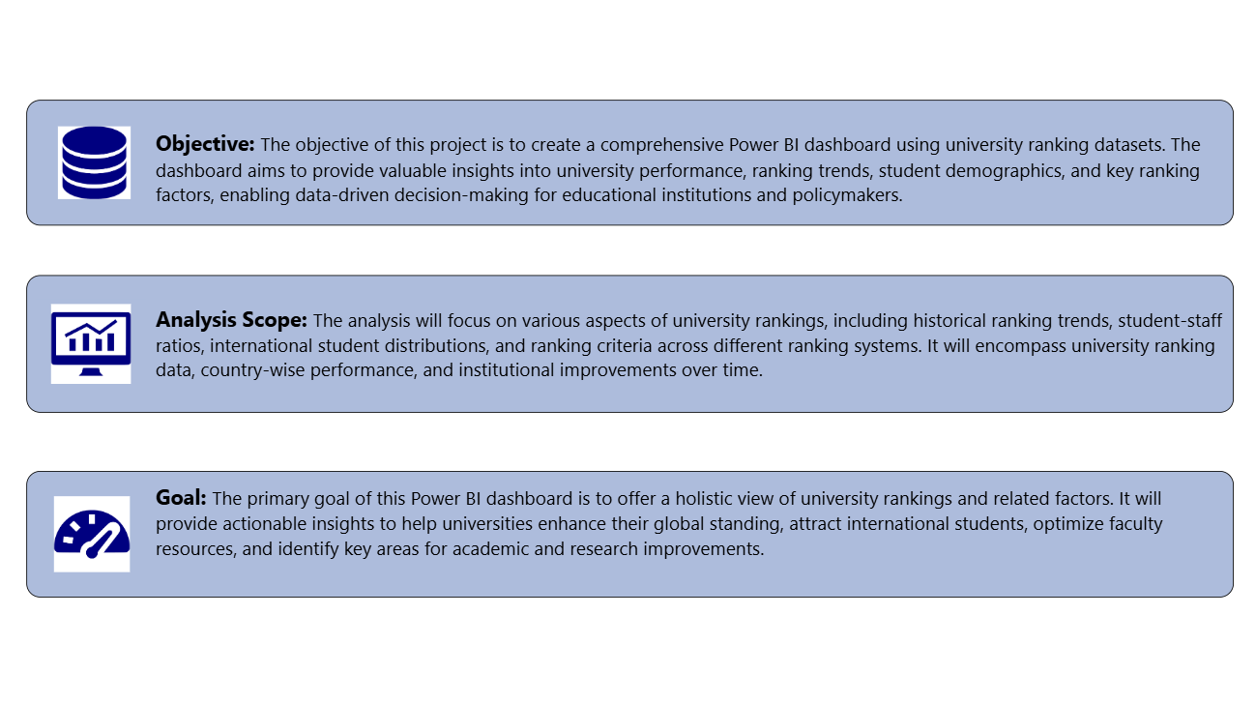

Slide 5
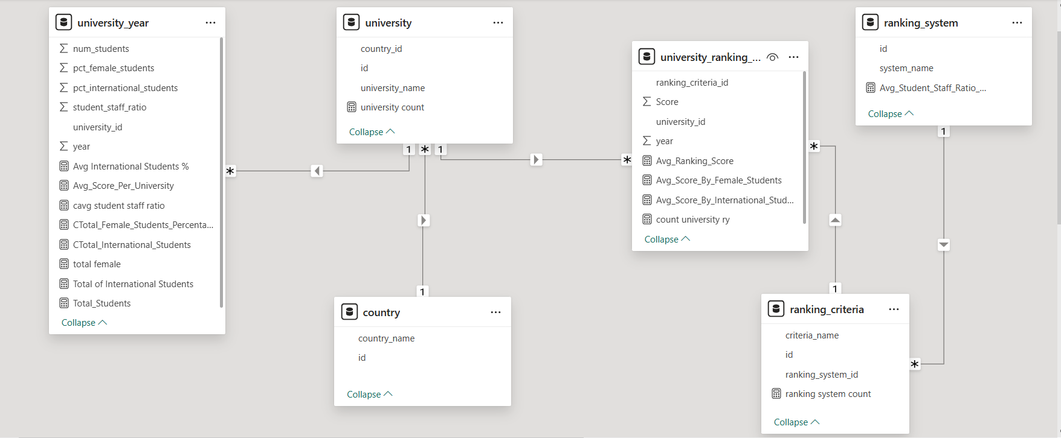
ER Diagram

Slide 6
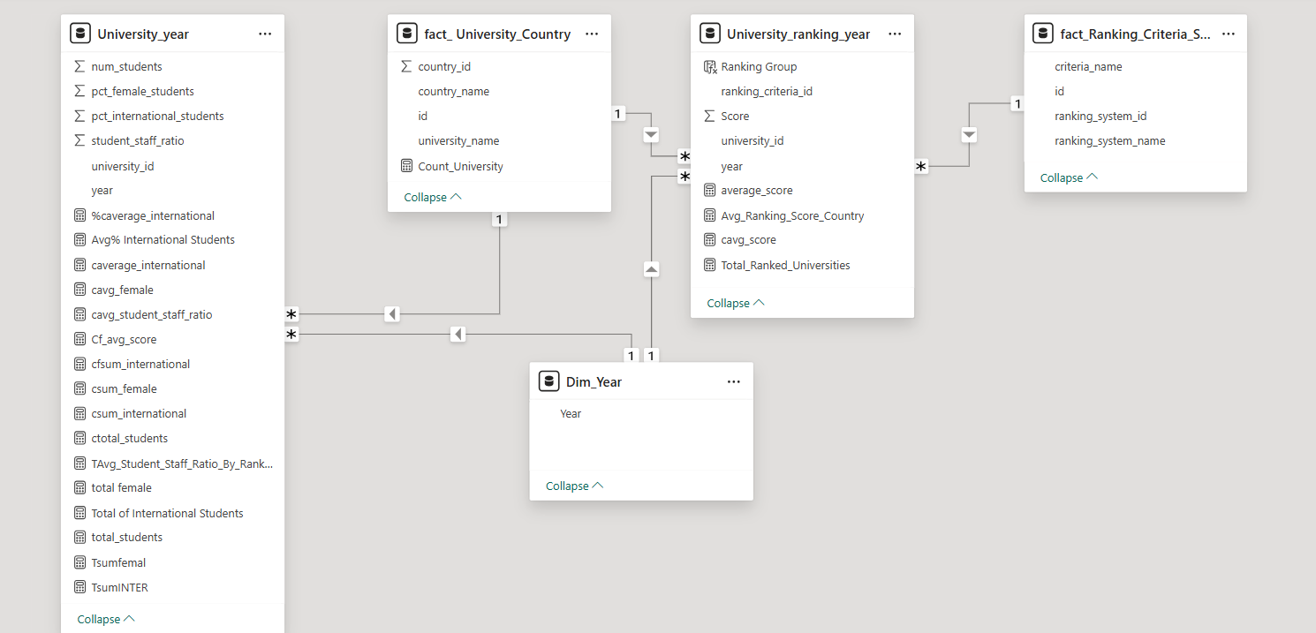
Simplified ER Diagram

Slide 7
Power BI Problem Statements

Slide 8
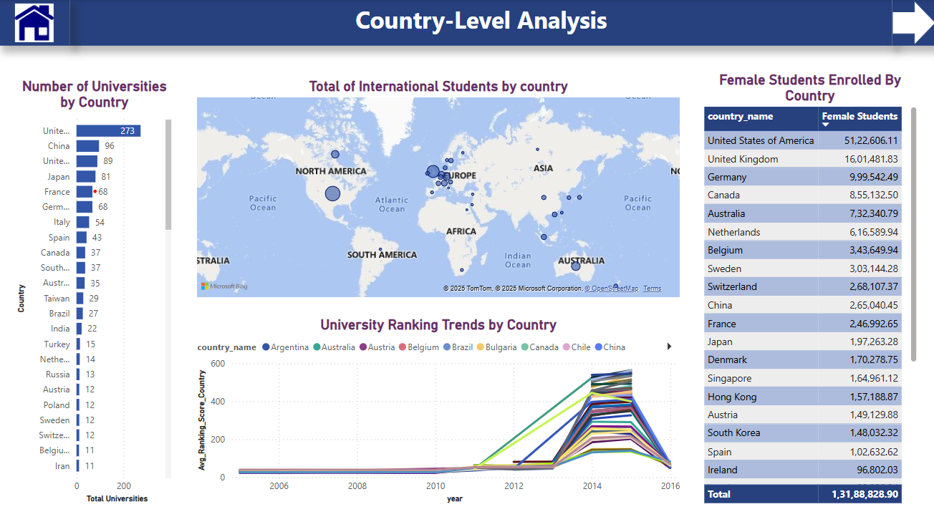

Slide 9
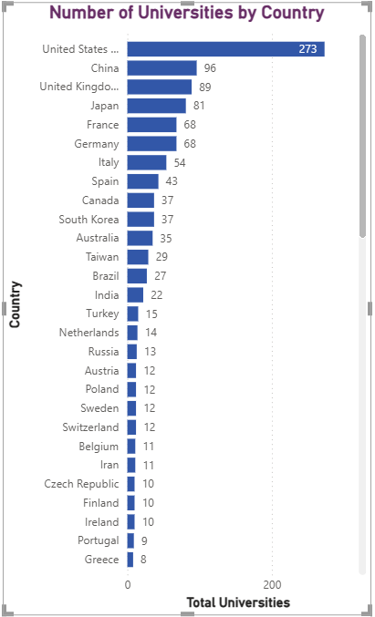
How many universities are there in each country?
The U.S. leads with the most ranked universities (273), followed by China (96) and the UK (89), highlighting their strong global presence in higher education. Countries with fewer ranked universities can improve competitiveness through research investment, academic quality, and global collaboration.

Slide 10
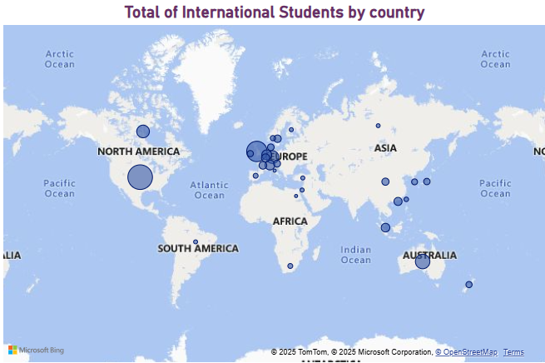
What is the distribution of international students across different countries?
The map visualization shows that the highest concentration of international students is in North America, Europe, and Australia, with relatively fewer in Egypt ,Italy. This suggests that universities in these regions are more attractive to international students, likely due to factors such as ranking, reputation, funding, and job opportunities..

Slide 11
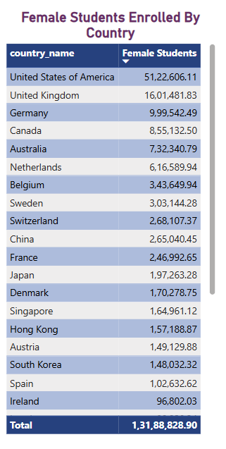
Which country has the highest number of female students enrolled in universities?
The United States leads in female student enrollment with 5.1 million, followed by the United Kingdom (1.6M) and Germany (1.0M). Countries like Canada, Australia, and the Netherlands also show high female participation in higher education. Some nations, such as Russia, Turkey, and Italy, show very low or missing data, which may require further investigation.

Slide 12
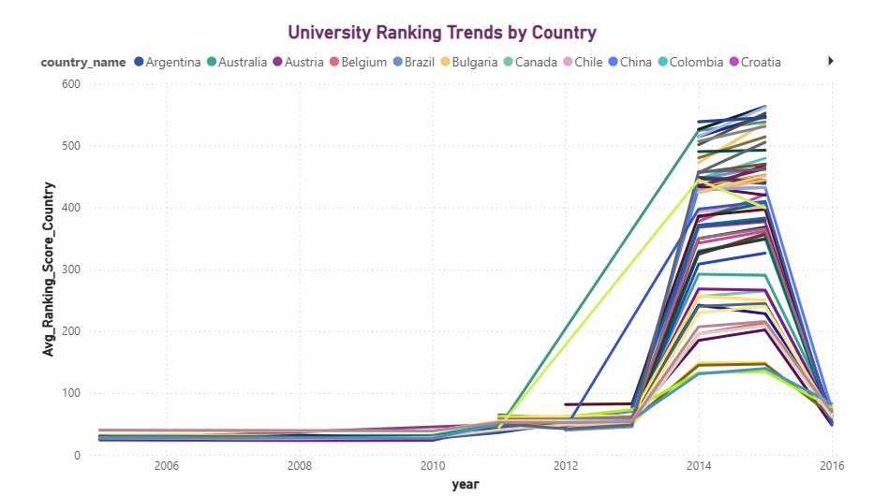
Are there any significant trends or patterns in the rankings of universities from different countries?
The sharp rise and fall in ranking scores around 2013–2014 is the significant trend we can see here this suggest changes in ranking methodologies, policies, or competition. Countries with stable trends may have consistent education policies, while fluctuating ones should investigate influencing factors.

Slide 13
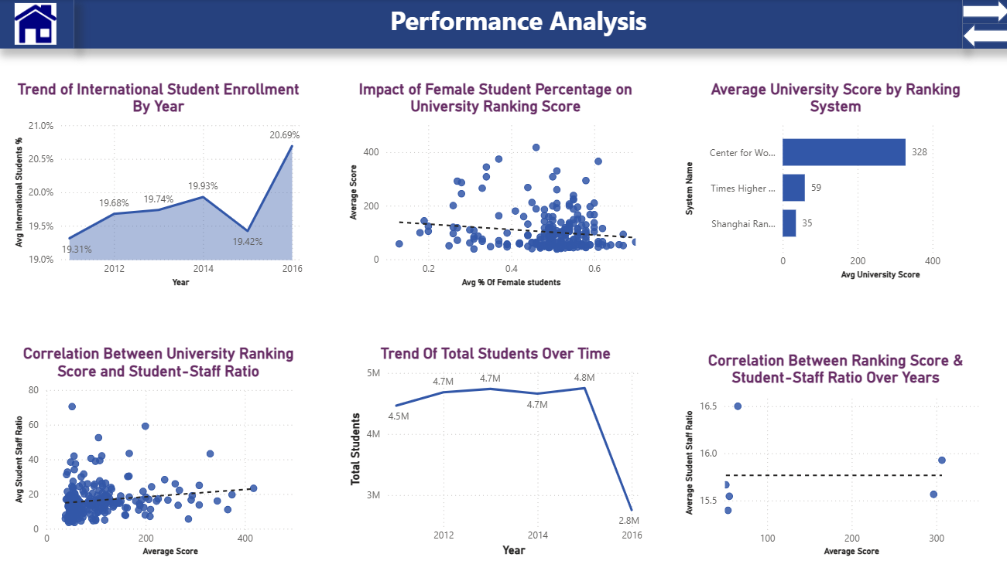

Slide 14
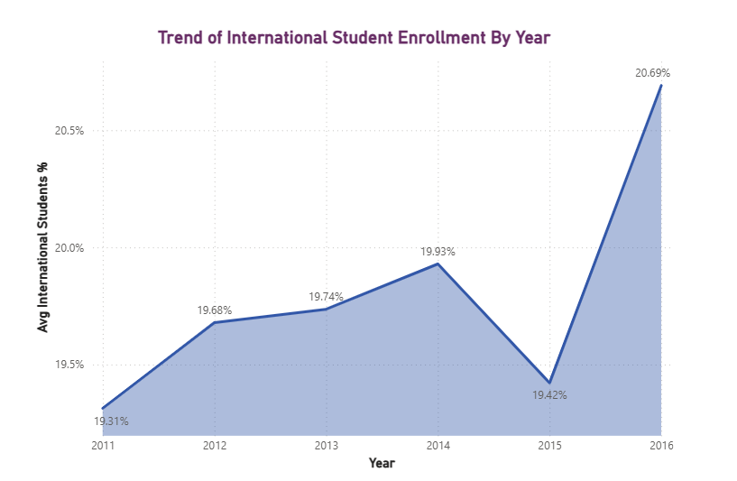
How does the percentage of international students vary across different years?
The percentage of international students showed steady growth until 2014, dipped in 2015, and then sharply increased in 2016. Universities should focus on sustaining this growth by improving support services and scholarships.

Slide 15
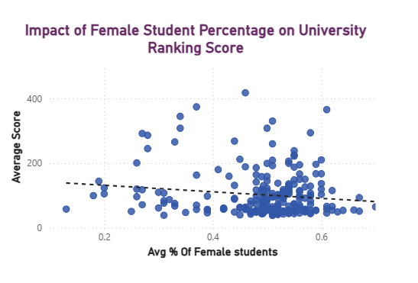
How does the percentage of female students impact a university's ranking?
The analysis reveals a weak negative correlation between the percentage of female students and university ranking scores. While universities with a higher proportion of female students tend to have slightly lower ranking scores, the trend is not strong enough to be a decisive factor

Slide 16
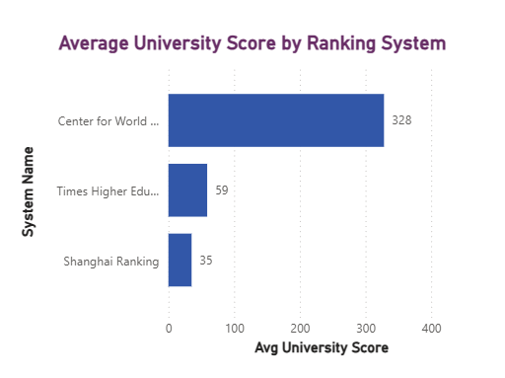
What is the average score for universities according to each ranking system?
The Center for World University Rankings (CWUR) assigns significantly higher average scores (328) compared to Times Higher Education (THE) (59) and Shanghai Rankings (35). This suggests that CWUR uses a broader or more lenient scoring system, whereas THE and Shanghai Rankings apply stricter or more compressed scoring criteria.

Slide 17
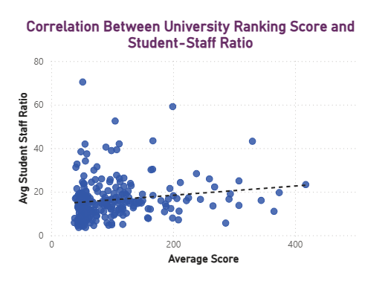
Is there a correlation between a university's ranking and its student-staff ratio?
The scatter plot suggests a weak positive correlation between the average score and the student-staff ratio. This means that universities with higher rankings (higher scores) tend to have a slightly higher student-staff ratio, but the relationship is not very strong.

Slide 18
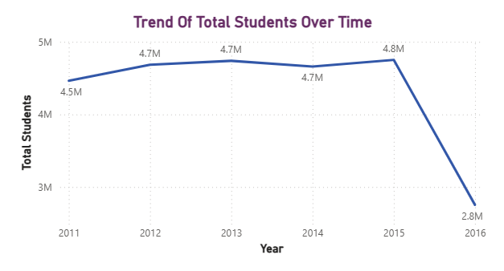
How does the number of students in universities change over time?
The total number of students showed steady growth from 2011 to 2015, peaking at 4.7 million. However, 2016 saw a sharp decline to 2.75 million, indicating potential policy changes, economic impacts, or data inconsistencies that need further investigation.

Slide 19
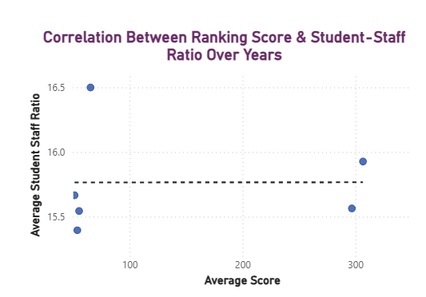
Is there a correlation between a university's ranking score and the student-staff ratio over the years?
The scatter plot indicates little to no correlation between ranking score and student-staff ratio. This suggests that ranking scores are influenced by multiple factors beyond staffing levels. Universities should adopt a holistic approach, improving faculty quality, research output, and funding to enhance rankings effectively.

Slide 20
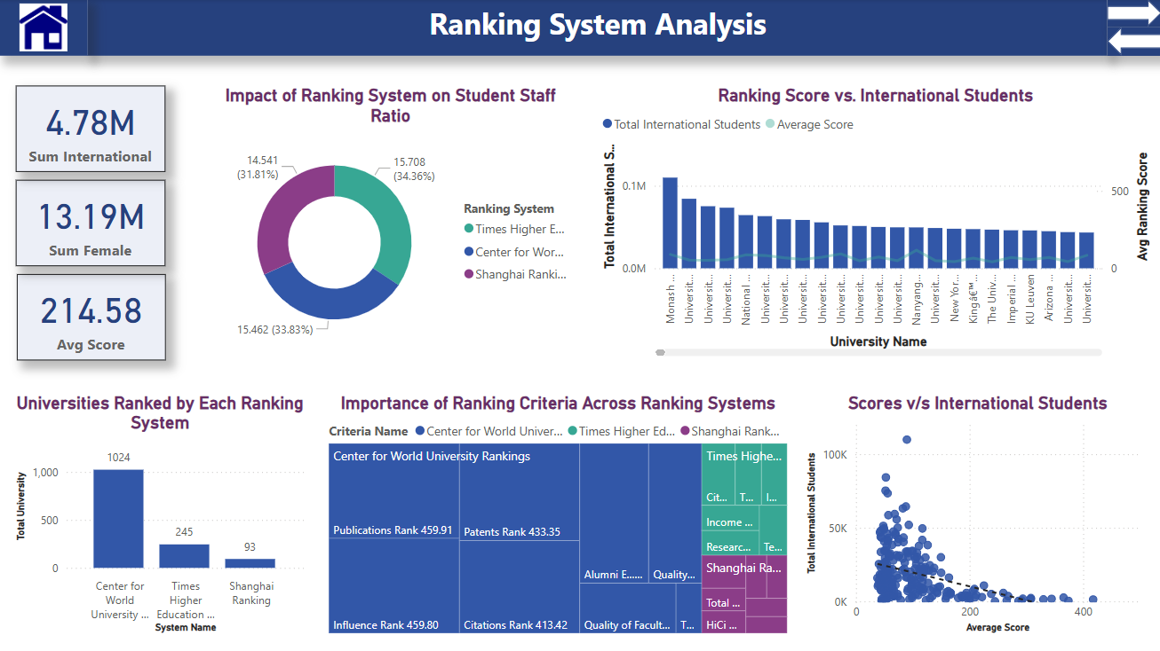

Slide 21
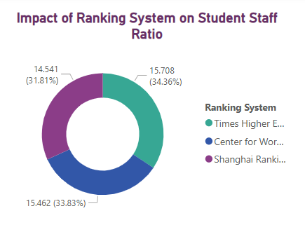
How does the ranking system affect a university's student-staff ratio?
The Times Higher Education (THE) ranking system reports the highest average student-staff ratio (15.708), while the Shanghai Ranking (15.462) and Center for World University Rankings (CWUR) (14.462) report slightly lower ratios. This suggests that THE ranks universities that tend to have a higher number of students per staff member, which may indicate a larger class size or fewer faculty members per student.

Slide 22
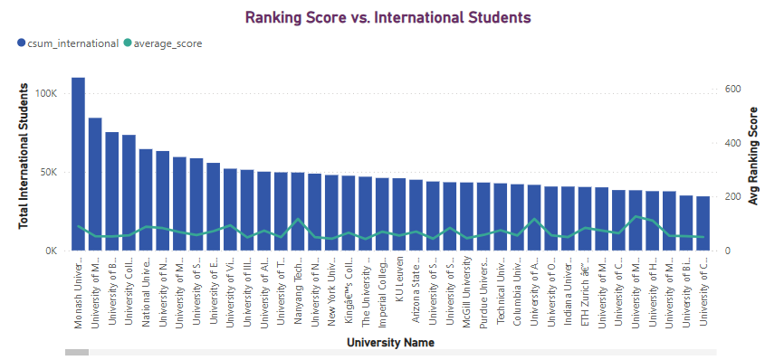
What is the impact of a university's ranking on the number of international students it attracts?
Higher-ranked universities do not always have the most international students, as seen with Monash University leading in enrollment despite a moderate ranking score. Factors like location, scholarships, and global reputation influence international student attraction beyond just ranking. Universities should focus on these aspects alongside ranking improvements to attract more international students.

Slide 23
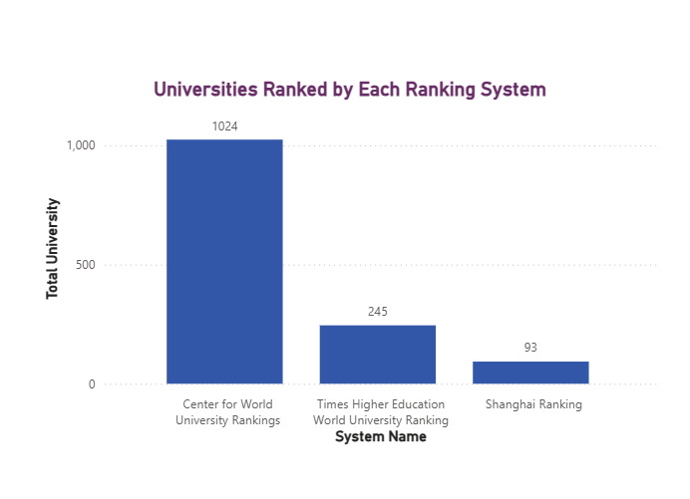
How many universities are ranked by each ranking system?
The chart reveals that the Center for World University Rankings (CWUR) ranks the highest number of universities (1,024), significantly more than the Times Higher Education (THE) Ranking (245) and the Shanghai Ranking (93). This suggests that CWUR takes a broader, more inclusive approach, while the Shanghai Ranking is highly selective, evaluating a much smaller number of institutions.

Slide 24
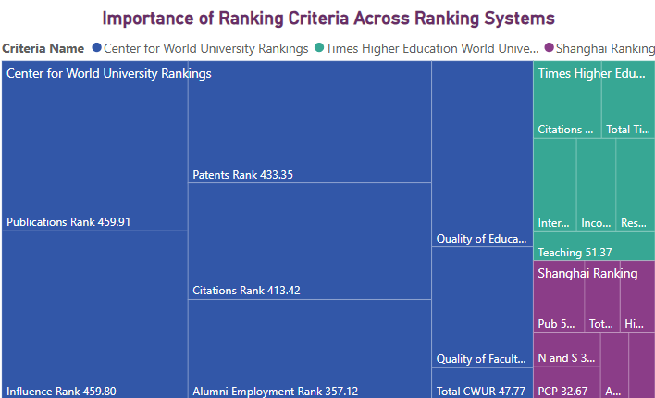
What are the most important criteria considered by ranking systems?
The Center for World University Rankings (CWUR) places the most emphasis on publications ranking (459.1),Then influence and less impact on total CWUR(47.77). Times Higher Education focuses on citations(76.83), while the Shanghai Ranking considers pub (54.01). This highlights how different ranking systems prioritize various criteria, meaning universities aiming to improve rankings should align their strategies accordingly.

Slide 25
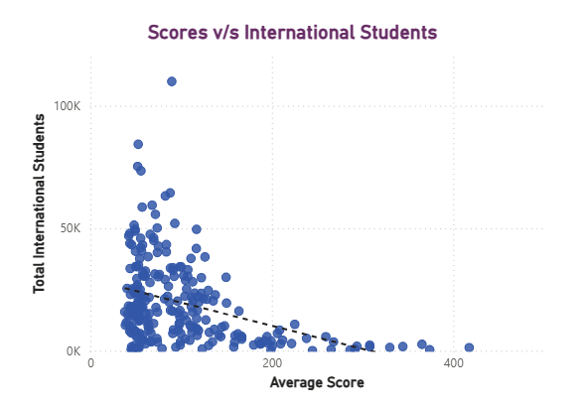
Is there a correlation between a university's score and the number of international students?
The scatter plot suggests an inverse correlation between university scores and the number of international students. Universities with higher scores tend to have fewer international students, while those with lower scores attract more international students. This may indicate that top-ranked universities are more selective or that other factors like tuition fees and admission policies influence international student enrollment.

Slide 26
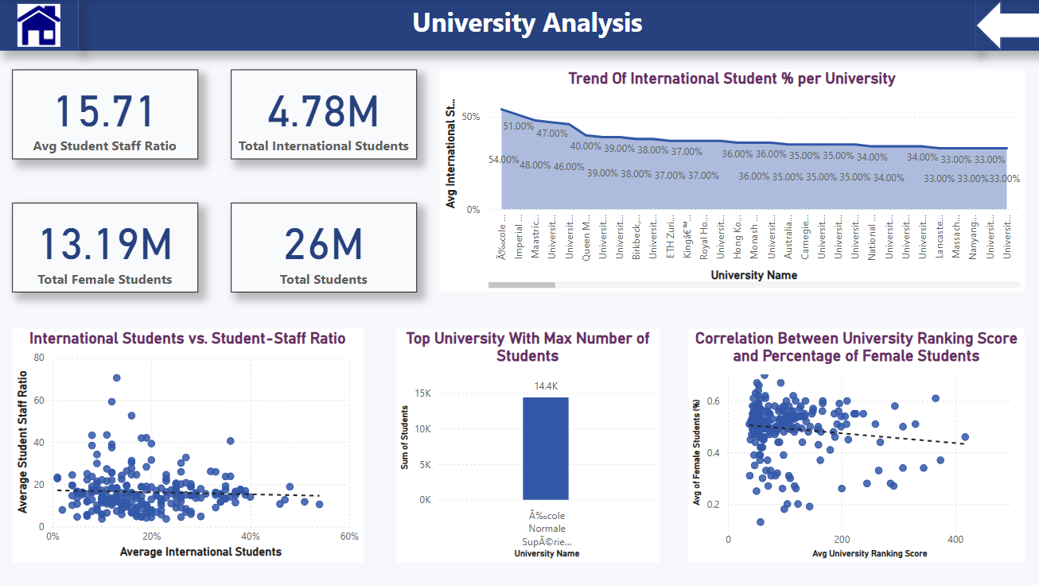

Slide 27
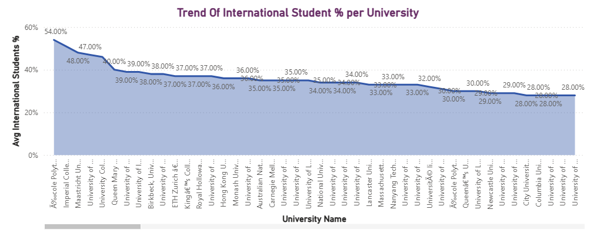
How does the percentage of international students vary across different universities?
The trend shows that some universities have a significantly higher percentage of international students, with the highest reaching 54%. This indicates strong global appeal and diverse student populations. However, there is a gradual decline in international student percentages across universities, suggesting variations in international student attraction based on factors like location, reputation, and policies.

Slide 28
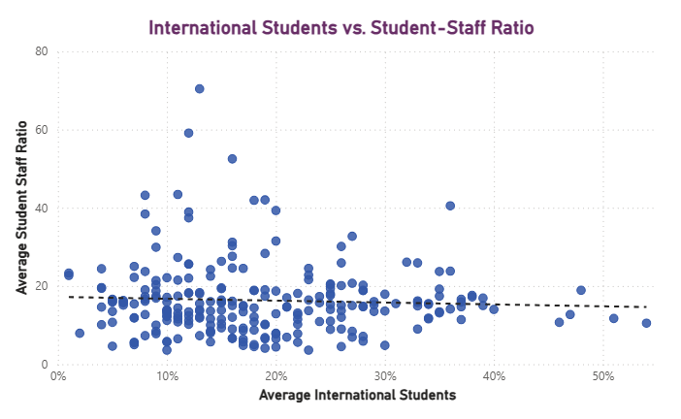
How does the percentage of international students affect a university's student-staff ratio?
The weak negative correlation suggests that universities with more international students tend to have a slightly lower student-staff ratio. Institutions should focus on maintaining faculty strength to ensure quality education as international enrollment grows.

Slide 29
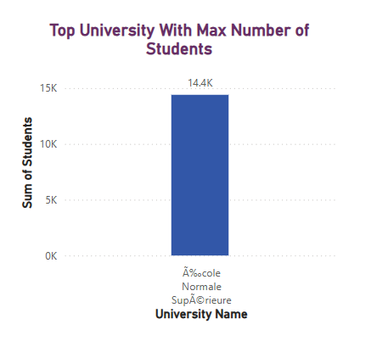
Which university has the highest number of students?
Arizona State University has the highest student enrollment, totaling 499,416.
This suggests a massive student body, potentially impacting faculty resources, student experience, and overall university performance.

Slide 30
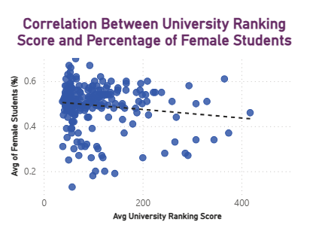
Is there a relationship between a university's ranking score and the percentage of female students enrolled?
Higher-ranked universities show a slight decline in female student percentages, indicating potential gender disparities. Institutions should promote inclusivity through scholarships and mentorship programs to encourage female enrollment.

Slide 31

EDA Problem Statements

Slide 32
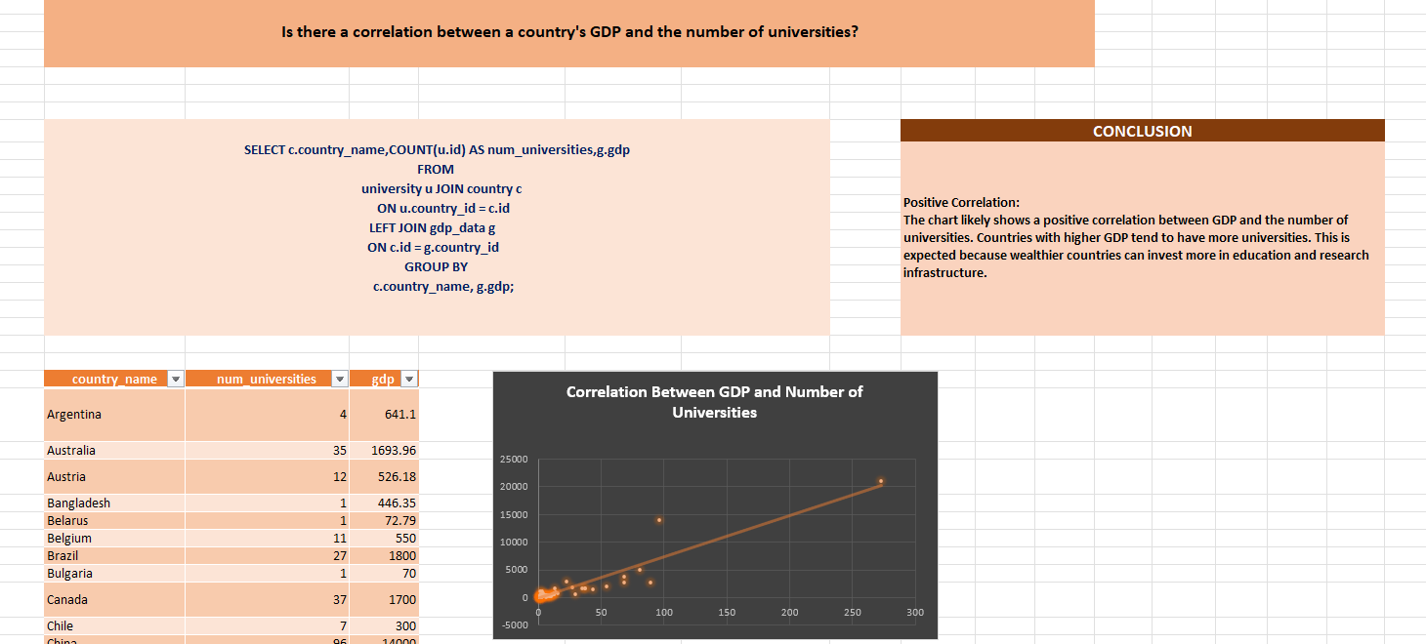

Slide 33
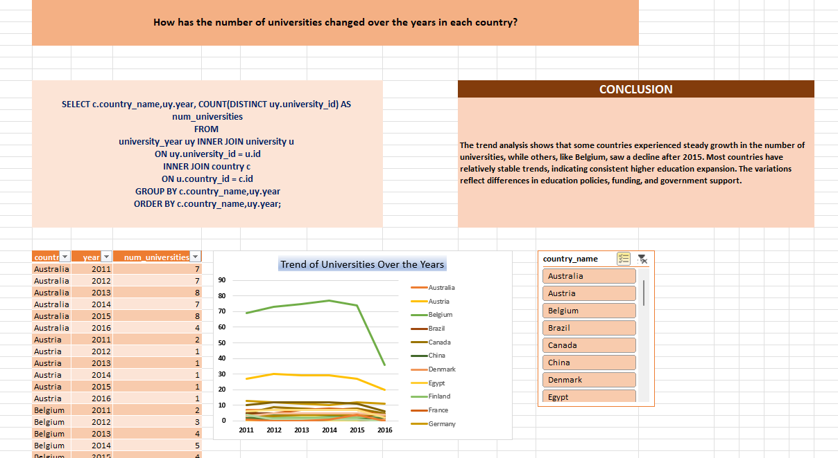

Slide 34
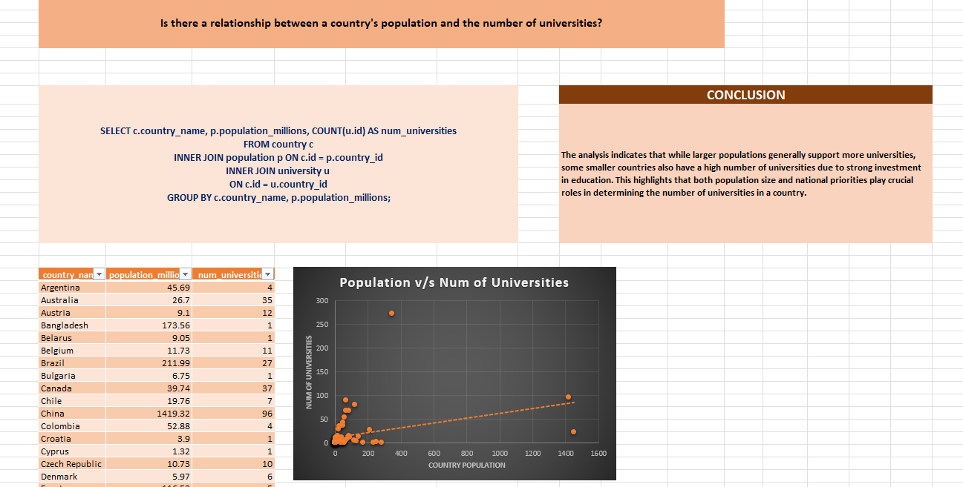

Slide 35
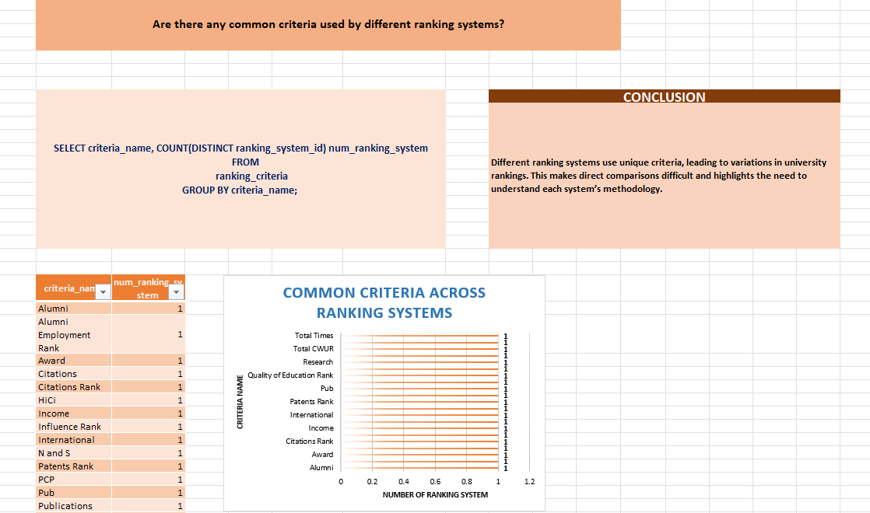

Slide 36
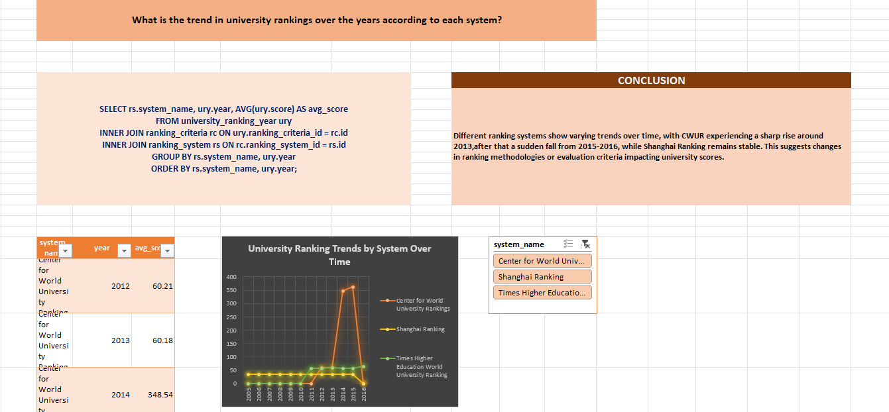

Slide 37
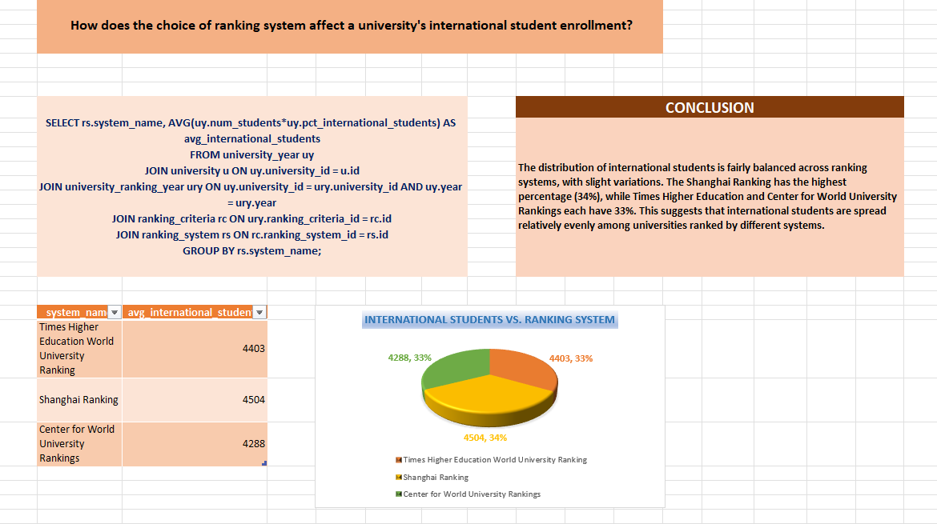

Slide 38
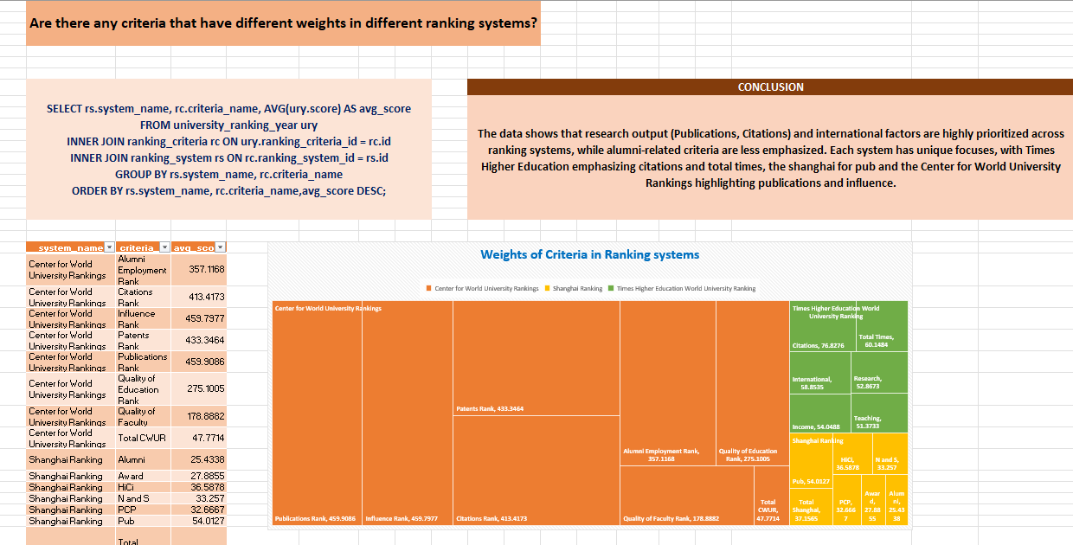

Slide 39
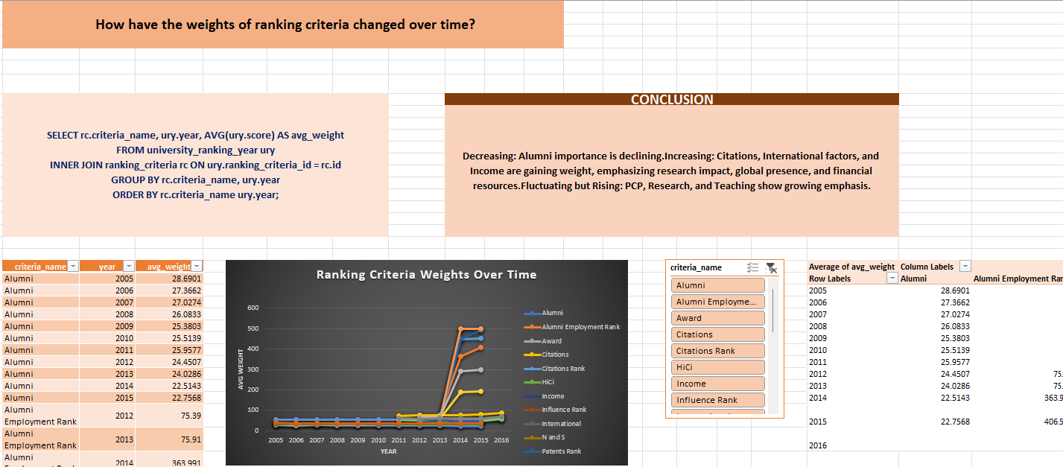

Slide 40
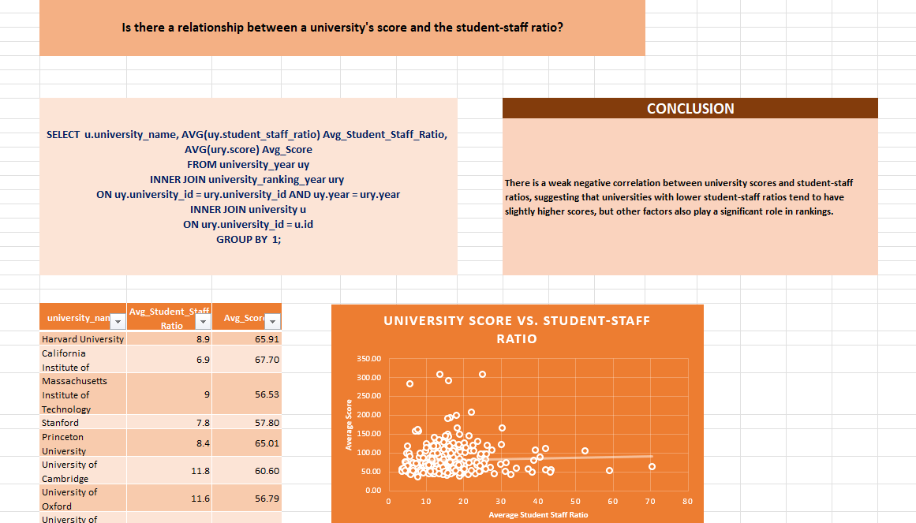

Slide 41
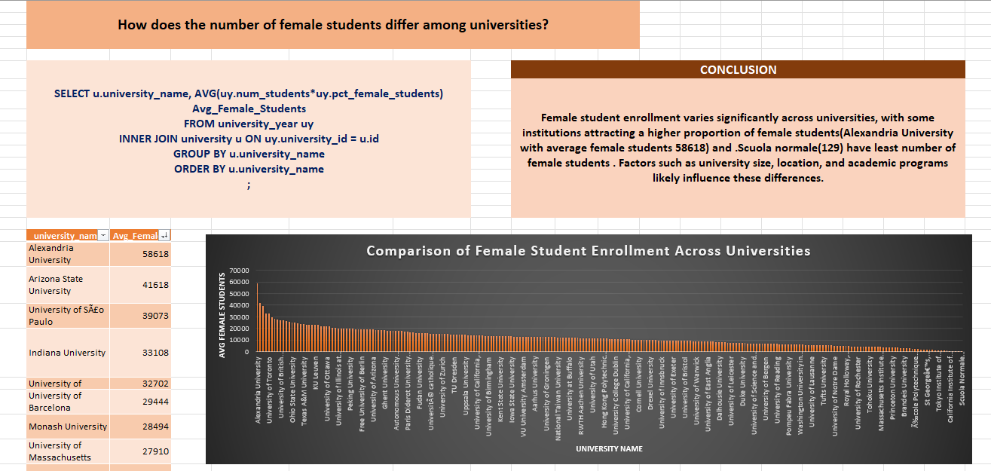

Slide 42
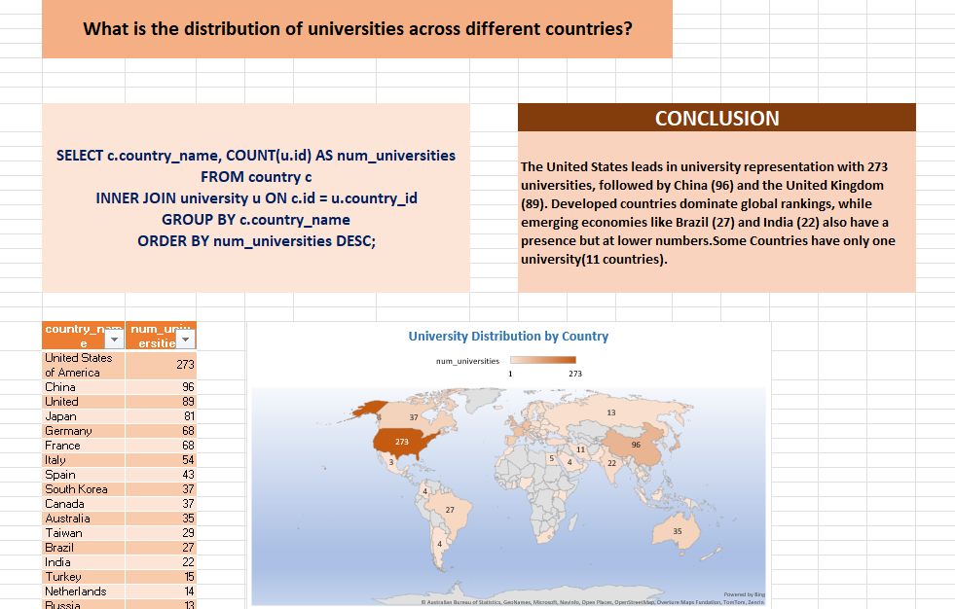

Slide 43
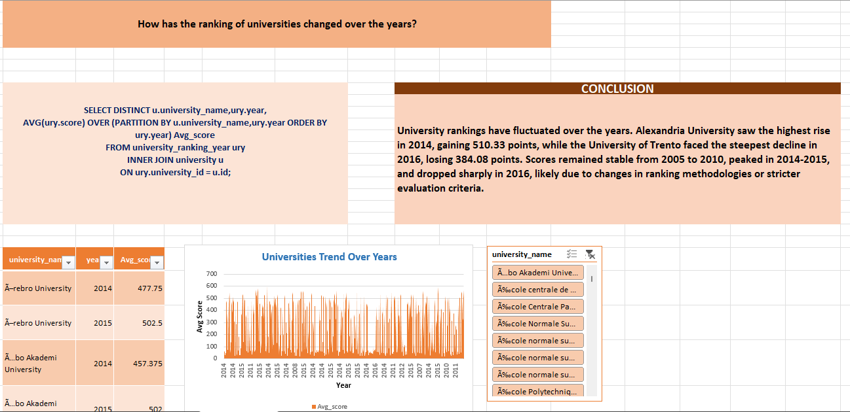

Slide 44
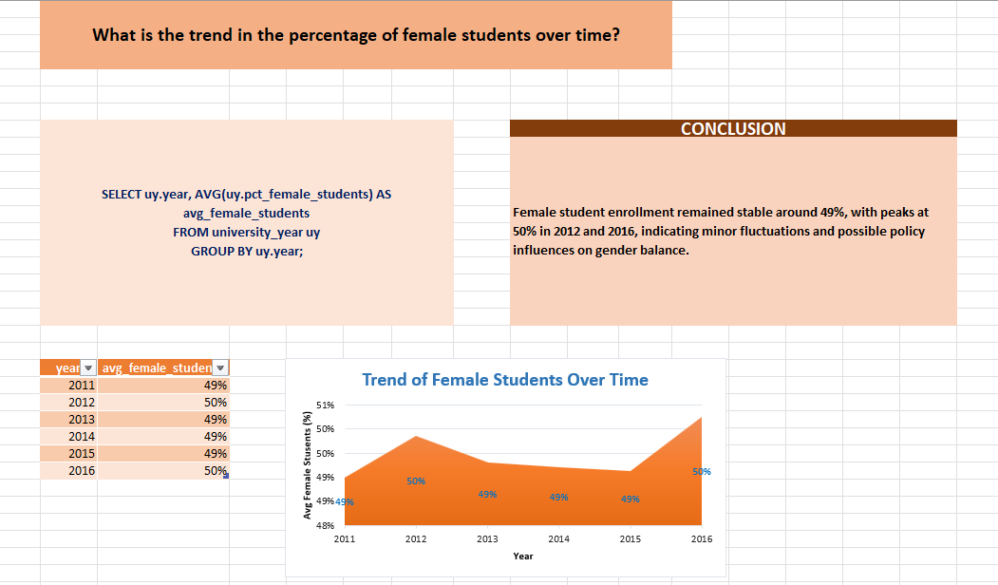

Slide 45
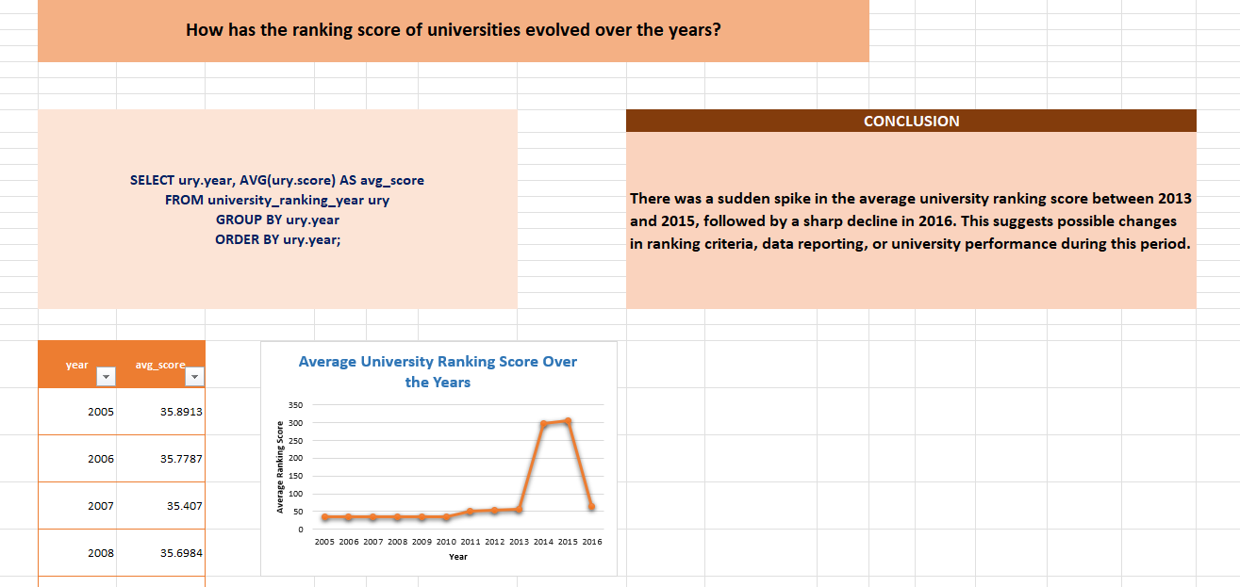

Slide 46
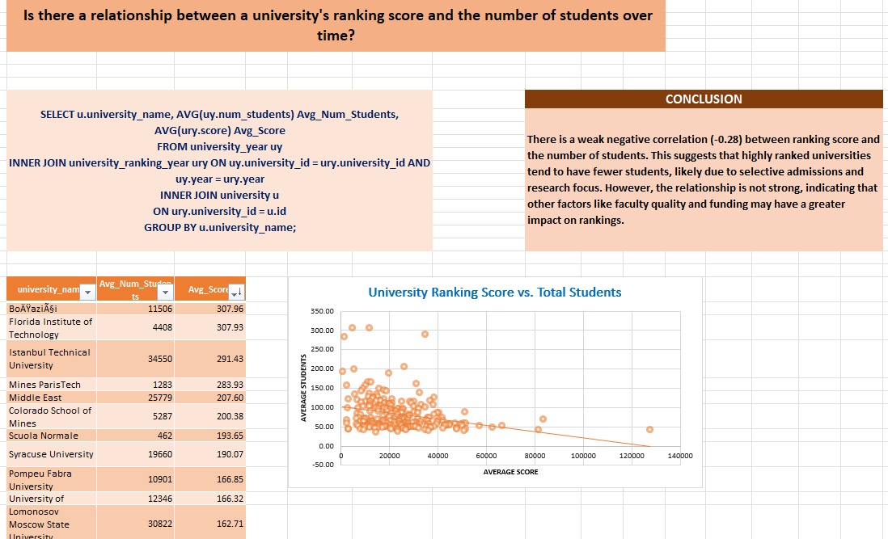

Slide 47
THANK YOU

